Slide 1
Dynamics 365 F&O (and AX) Integrations with Logic Apps

Slide 2
Introductions
What are Logic Apps?
What can they do?
Use Cases with Diagrams
Demo
Scale

Slide 3

Nathan Clouse
Technical Architect enVista Corp.
Microsoft Business Applications MVP (3x)
nclouse@envistacorp.com
www.atomicax.com
www.dynamics.fo
@NathanClouseAX
Nathan Clouse
Technical Architect, Microsoft MVP
enVista Corp.

Slide 4
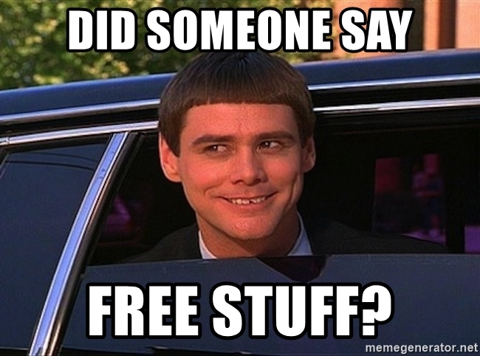
Gift Card Giveaway
….. At the end

Slide 5
What Are Logic Apps?
“Azure Logic Apps is a leading integration platform as a service (iPaaS) built on a containerized runtime. Deploy and run Logic Apps anywhere to increase scale and portability while automating business-critical workflows anywhere.”

Slide 6
What Are Logic Apps?
Cloud Service to move and transform data from a place to another place

Slide 7
Parts of Logic App
Workflows
Connectors
Actions
Trigger

Slide 8
Workflows
Sequence of actions or processed defined into steps
perform the business operations when input is provided
Every workflow will be initiated by the trigger being fired
Business processes can be automated and visualized in a hierarchy

Slide 9
Connectors
perform certain actions or processes and they are designed to connect and work with user data
either as actions or as triggers
Lots of prebuilt connectors to Microsoft and third-party services
Built-in – Schedule, HTTP, Request, Azure App Services, API Management
Managed connectors – Azure service bus, Azure Blob Storage, SQL Server, Office365 outlook, Azure Event Hubs, Salesforce
On-premises connectors – Biztalk Server, Oracle DB, File system, IBM DB2, MYSQL.
Enterprise connectors – IBM 3270, IBM MQ, SAP

Slide 10
Actions
Actions are the step(s) that run once initiated by the trigger

Slide 11
Triggers
Starting point for an Azure Logic App workflow
Connectors in Logic Apps itself provide various triggers
Custom triggers can also be created using custom connectors
Users can also define multiple triggers in a Logic App

Slide 12
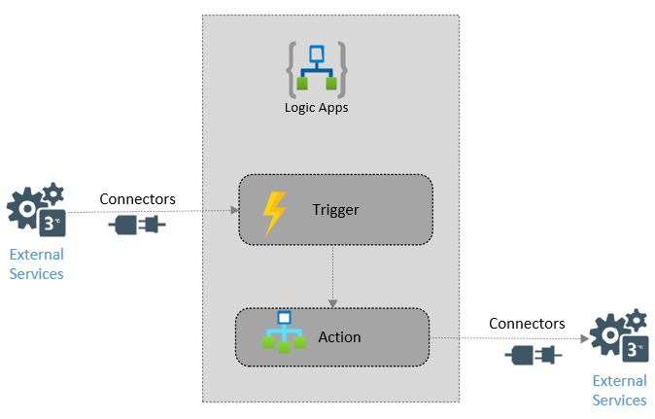

Slide 13
Pros and Cons
Pros
Cons
No Code – Low Code, Workflow Driven
Drag and Drop UI
Cost Effective – pay as you go
Hundreds+ OOTB connectors to 3rd parties
“Serverless”
Built in Monitoring
Modern
Connect to cloud and on-premise resources
No upfront cost
Ongoing cost – pay as you go
Not always a fit for complex scenarios
Sometimes less than elegant solutions

Slide 14
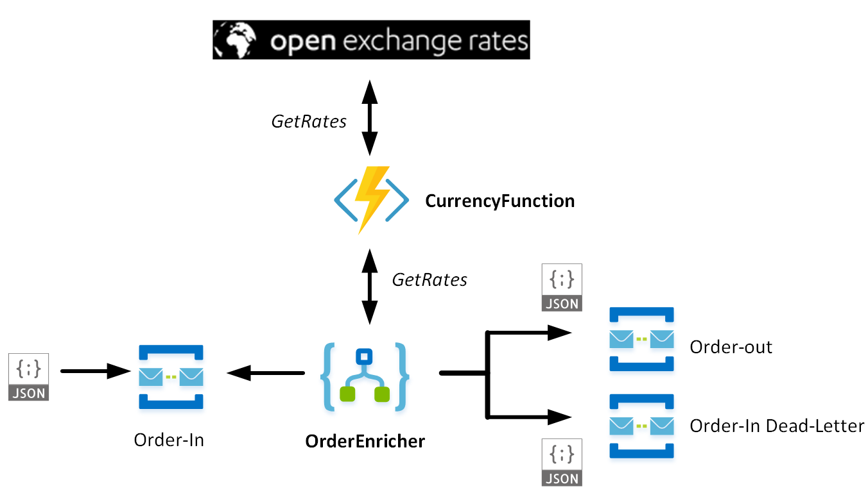

Slide 15
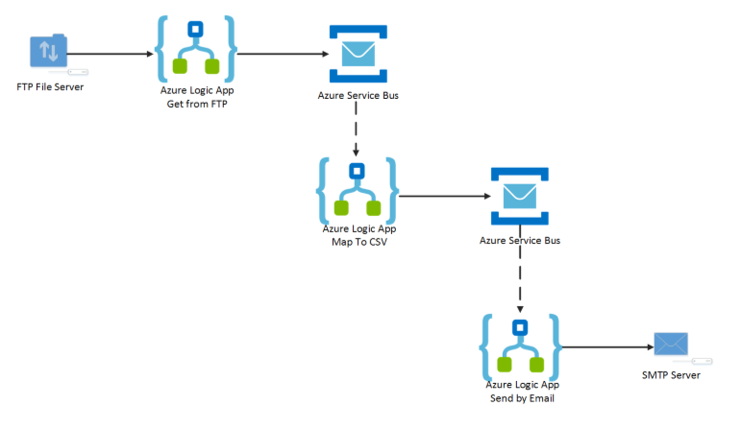

Slide 16
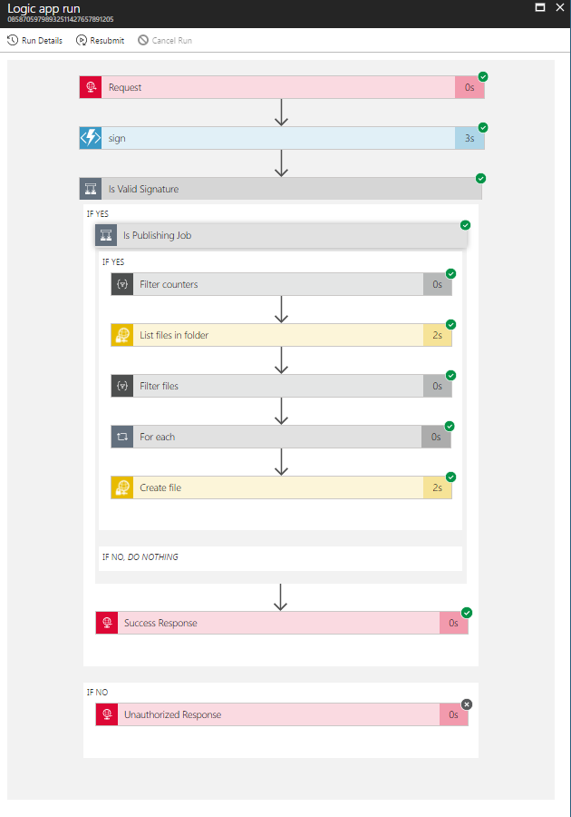

Slide 20
Power Automate Vs. LogicApps Vs. FunctionApps

Slide 21
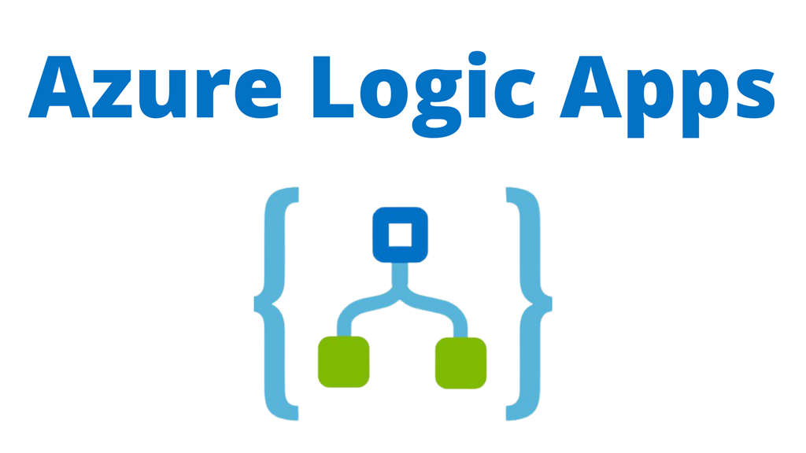
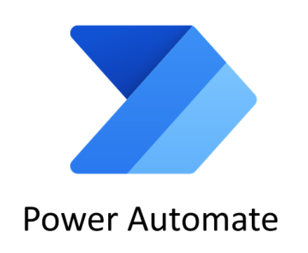
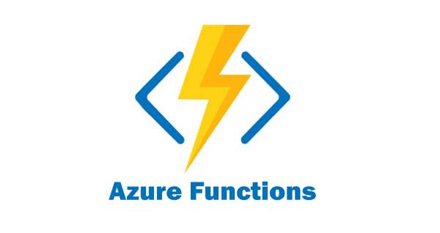
Logos

Slide 22
Power Automate Vs LogicApps
 | Power Automate | Logic Apps
Users | Office workers, business users, SharePoint administrators | Pro integrators and developers, IT pros
Scenarios | Self-service | Advanced integrations
Design tool | In-browser and mobile app, UI only | In-browser, Visual Studio Code, and Visual Studio with code view available
Application lifecycle management (ALM) | Design and test in non-production environments, promote to production when ready | Azure DevOps: source control, testing, support, automation, and manageability in Azure Resource Manager
Admin experience | Manage Power Automate environments and data loss prevention (DLP) policies, track licensing: Admin center | Manage resource groups, connections, access management, and logging: Azure portal
Security | Microsoft 365 security audit logs, DLP, encryption at rest for sensitive data | Security assurance of Azure: Azure security, Microsoft Defender for Cloud, audit logs

Slide 23
Power Automate Vs LogicApps
 | Power Automate | Logic Apps
Users | Office workers, business users, SharePoint administrators | Pro integrators and developers, IT pros
Scenarios | Self-service | Advanced integrations
Design tool | In-browser and mobile app, UI only | In-browser, Visual Studio Code, and Visual Studio with code view available
Application lifecycle management (ALM) | Design and test in non-production environments, promote to production when ready | Azure DevOps: source control, testing, support, automation, and manageability in Azure Resource Manager
Admin experience | Manage Power Automate environments and data loss prevention (DLP) policies, track licensing: Admin center | Manage resource groups, connections, access management, and logging: Azure portal
Security | Microsoft 365 security audit logs, DLP, encryption at rest for sensitive data | Security assurance of Azure: Azure security, Microsoft Defender for Cloud, audit logs

Slide 24
Power Automate Vs LogicApps
 | Power Automate | Logic Apps
Users | Office workers, business users, SharePoint administrators | Pro integrators and developers, IT pros
Scenarios | Self-service | Advanced integrations
Design tool | In-browser and mobile app, UI only | In-browser, Visual Studio Code, and Visual Studio with code view available
Application lifecycle management (ALM) | Design and test in non-production environments, promote to production when ready | Azure DevOps: source control, testing, support, automation, and manageability in Azure Resource Manager
Admin experience | Manage Power Automate environments and data loss prevention (DLP) policies, track licensing: Admin center | Manage resource groups, connections, access management, and logging: Azure portal
Security | Microsoft 365 security audit logs, DLP, encryption at rest for sensitive data | Security assurance of Azure: Azure security, Microsoft Defender for Cloud, audit logs

Slide 25
Power Automate Vs LogicApps
 | Power Automate | Logic Apps
Users | Office workers, business users, SharePoint administrators | Pro integrators and developers, IT pros
Scenarios | Self-service | Advanced integrations
Design tool | In-browser and mobile app, UI only | In-browser, Visual Studio Code, and Visual Studio with code view available
Application lifecycle management (ALM) | Design and test in non-production environments, promote to production when ready | Azure DevOps: source control, testing, support, automation, and manageability in Azure Resource Manager
Admin experience | Manage Power Automate environments and data loss prevention (DLP) policies, track licensing: Admin center | Manage resource groups, connections, access management, and logging: Azure portal
Security | Microsoft 365 security audit logs, DLP, encryption at rest for sensitive data | Security assurance of Azure: Azure security, Microsoft Defender for Cloud, audit logs

Slide 26
Power Automate Vs LogicApps
 | Power Automate | Logic Apps
Users | Office workers, business users, SharePoint administrators | Pro integrators and developers, IT pros
Scenarios | Self-service | Advanced integrations
Design tool | In-browser and mobile app, UI only | In-browser, Visual Studio Code, and Visual Studio with code view available
Application lifecycle management (ALM) | Design and test in non-production environments, promote to production when ready | Azure DevOps: source control, testing, support, automation, and manageability in Azure Resource Manager
Admin experience | Manage Power Automate environments and data loss prevention (DLP) policies, track licensing: Admin center | Manage resource groups, connections, access management, and logging: Azure portal
Security | Microsoft 365 security audit logs, DLP, encryption at rest for sensitive data | Security assurance of Azure: Azure security, Microsoft Defender for Cloud, audit logs

Slide 27
Power Automate Vs LogicApps
 | Power Automate | Logic Apps
Users | Office workers, business users, SharePoint administrators | Pro integrators and developers, IT pros
Scenarios | Self-service | Advanced integrations
Design tool | In-browser and mobile app, UI only | In-browser, Visual Studio Code, and Visual Studio with code view available
Application lifecycle management (ALM) | Design and test in non-production environments, promote to production when ready | Azure DevOps: source control, testing, support, automation, and manageability in Azure Resource Manager
Admin experience | Manage Power Automate environments and data loss prevention (DLP) policies, track licensing: Admin center | Manage resource groups, connections, access management, and logging: Azure portal
Security | Microsoft 365 security audit logs, DLP, encryption at rest for sensitive data | Security assurance of Azure: Azure security, Microsoft Defender for Cloud, audit logs

Slide 28
Power Automate Vs LogicApps
 | Power Automate | Logic Apps
Users | Office workers, business users, SharePoint administrators | Pro integrators and developers, IT pros
Scenarios | Self-service | Advanced integrations
Design tool | In-browser and mobile app, UI only | In-browser, Visual Studio Code, and Visual Studio with code view available
Application lifecycle management (ALM) | Design and test in non-production environments, promote to production when ready | Azure DevOps: source control, testing, support, automation, and manageability in Azure Resource Manager
Admin experience | Manage Power Automate environments and data loss prevention (DLP) policies, track licensing: Admin center | Manage resource groups, connections, access management, and logging: Azure portal
Security | Microsoft 365 security audit logs, DLP, encryption at rest for sensitive data | Security assurance of Azure: Azure security, Microsoft Defender for Cloud, audit logs

Slide 29
Power Automate Vs LogicApps
 | Power Automate | Logic Apps
Users | Office workers, business users, SharePoint administrators | Pro integrators and developers, IT pros
Scenarios | Self-service | Advanced integrations
Design tool | In-browser and mobile app, UI only | In-browser, Visual Studio Code, and Visual Studio with code view available
Application lifecycle management (ALM) | Design and test in non-production environments, promote to production when ready | Azure DevOps: source control, testing, support, automation, and manageability in Azure Resource Manager
Admin experience | Manage Power Automate environments and data loss prevention (DLP) policies, track licensing: Admin center | Manage resource groups, connections, access management, and logging: Azure portal
Security | Microsoft 365 security audit logs, DLP, encryption at rest for sensitive data | Security assurance of Azure: Azure security, Microsoft Defender for Cloud, audit logs

Slide 30
Power Automate Vs LogicApps
 | Power Automate | Logic Apps
Users | Office workers, business users, SharePoint administrators | Pro integrators and developers, IT pros
Scenarios | Self-service | Advanced integrations
Design tool | In-browser and mobile app, UI only | In-browser, Visual Studio Code, and Visual Studio with code view available
Application lifecycle management (ALM) | Design and test in non-production environments, promote to production when ready | Azure DevOps: source control, testing, support, automation, and manageability in Azure Resource Manager
Admin experience | Manage Power Automate environments and data loss prevention (DLP) policies, track licensing: Admin center | Manage resource groups, connections, access management, and logging: Azure portal
Security | Microsoft 365 security audit logs, DLP, encryption at rest for sensitive data | Security assurance of Azure: Azure security, Microsoft Defender for Cloud, audit logs

Slide 31
Power Automate Vs LogicApps
 | Power Automate | Logic Apps
Users | Office workers, business users, SharePoint administrators | Pro integrators and developers, IT pros
Scenarios | Self-service | Advanced integrations
Design tool | In-browser and mobile app, UI only | In-browser, Visual Studio Code, and Visual Studio with code view available
Application lifecycle management (ALM) | Design and test in non-production environments, promote to production when ready | Azure DevOps: source control, testing, support, automation, and manageability in Azure Resource Manager
Admin experience | Manage Power Automate environments and data loss prevention (DLP) policies, track licensing: Admin center | Manage resource groups, connections, access management, and logging: Azure portal
Security | Microsoft 365 security audit logs, DLP, encryption at rest for sensitive data | Security assurance of Azure: Azure security, Microsoft Defender for Cloud, audit logs

Slide 32
Power Automate Vs LogicApps
 | Power Automate | Logic Apps
Users | Office workers, business users, SharePoint administrators | Pro integrators and developers, IT pros
Scenarios | Self-service | Advanced integrations
Design tool | In-browser and mobile app, UI only | In-browser, Visual Studio Code, and Visual Studio with code view available
Application lifecycle management (ALM) | Design and test in non-production environments, promote to production when ready | Azure DevOps: source control, testing, support, automation, and manageability in Azure Resource Manager
Admin experience | Manage Power Automate environments and data loss prevention (DLP) policies, track licensing: Admin center | Manage resource groups, connections, access management, and logging: Azure portal
Security | Microsoft 365 security audit logs, DLP, encryption at rest for sensitive data | Security assurance of Azure: Azure security, Microsoft Defender for Cloud, audit logs

Slide 33
Power Automate Vs LogicApps
 | Power Automate | Logic Apps
Users | Office workers, business users, SharePoint administrators | Pro integrators and developers, IT pros
Scenarios | Self-service | Advanced integrations
Design tool | In-browser and mobile app, UI only | In-browser, Visual Studio Code, and Visual Studio with code view available
Application lifecycle management (ALM) | Design and test in non-production environments, promote to production when ready | Azure DevOps: source control, testing, support, automation, and manageability in Azure Resource Manager
Admin experience | Manage Power Automate environments and data loss prevention (DLP) policies, track licensing: Admin center | Manage resource groups, connections, access management, and logging: Azure portal
Security | Microsoft 365 security audit logs, DLP, encryption at rest for sensitive data | Security assurance of Azure: Azure security, Microsoft Defender for Cloud, audit logs

Slide 34
Power Automate Vs LogicApps
 | Power Automate | Logic Apps
Users | Office workers, business users, SharePoint administrators | Pro integrators and developers, IT pros
Scenarios | Self-service | Advanced integrations
Design tool | In-browser and mobile app, UI only | In-browser, Visual Studio Code, and Visual Studio with code view available
Application lifecycle management (ALM) | Design and test in non-production environments, promote to production when ready | Azure DevOps: source control, testing, support, automation, and manageability in Azure Resource Manager
Admin experience | Manage Power Automate environments and data loss prevention (DLP) policies, track licensing: Admin center | Manage resource groups, connections, access management, and logging: Azure portal
Security | Microsoft 365 security audit logs, DLP, encryption at rest for sensitive data | Security assurance of Azure: Azure security, Microsoft Defender for Cloud, audit logs

Slide 35
LogicApps Vs. FunctionApps
 | Function Apps (Durable Functions) | Logic Apps
Development | Code-first (imperative) | Designer-first (declarative)
Connectivity | About a dozen built-in binding types, write code for custom bindings | Large collection of connectors, Enterprise Integration Pack for B2B scenarios, build custom connectors
Actions | Each activity is an Azure function; write code for activity functions | Large collection of ready-made actions
Monitoring | Azure Application Insights | Azure portal, Azure Monitor logs, Microsoft Defender for Cloud
Management | REST API, Visual Studio | Azure portal, REST API, PowerShell, Visual Studio
Execution context | Can run locally or in the cloud | Runs in Azure, locally, or on premises.

Slide 36
LogicApps Vs. FunctionApps
 | Function Apps (Durable Functions) | Logic Apps
Development | Code-first (imperative) | Designer-first (declarative)
Connectivity | About a dozen built-in binding types, write code for custom bindings | Large collection of connectors, Enterprise Integration Pack for B2B scenarios, build custom connectors
Actions | Each activity is an Azure function; write code for activity functions | Large collection of ready-made actions
Monitoring | Azure Application Insights | Azure portal, Azure Monitor logs, Microsoft Defender for Cloud
Management | REST API, Visual Studio | Azure portal, REST API, PowerShell, Visual Studio
Execution context | Can run locally or in the cloud | Runs in Azure, locally, or on premises.

Slide 37
LogicApps Vs. FunctionApps
 | Function Apps (Durable Functions) | Logic Apps
Development | Code-first (imperative) | Designer-first (declarative)
Connectivity | About a dozen built-in binding types, write code for custom bindings | Large collection of connectors, Enterprise Integration Pack for B2B scenarios, build custom connectors
Actions | Each activity is an Azure function; write code for activity functions | Large collection of ready-made actions
Monitoring | Azure Application Insights | Azure portal, Azure Monitor logs, Microsoft Defender for Cloud
Management | REST API, Visual Studio | Azure portal, REST API, PowerShell, Visual Studio
Execution context | Can run locally or in the cloud | Runs in Azure, locally, or on premises.

Slide 38
LogicApps Vs. FunctionApps
 | Function Apps (Durable Functions) | Logic Apps
Development | Code-first (imperative) | Designer-first (declarative)
Connectivity | About a dozen built-in binding types, write code for custom bindings | Large collection of connectors, Enterprise Integration Pack for B2B scenarios, build custom connectors
Actions | Each activity is an Azure function; write code for activity functions | Large collection of ready-made actions
Monitoring | Azure Application Insights | Azure portal, Azure Monitor logs, Microsoft Defender for Cloud
Management | REST API, Visual Studio | Azure portal, REST API, PowerShell, Visual Studio
Execution context | Can run locally or in the cloud | Runs in Azure, locally, or on premises.

Slide 39
LogicApps Vs. FunctionApps
 | Function Apps (Durable Functions) | Logic Apps
Development | Code-first (imperative) | Designer-first (declarative)
Connectivity | About a dozen built-in binding types, write code for custom bindings | Large collection of connectors, Enterprise Integration Pack for B2B scenarios, build custom connectors
Actions | Each activity is an Azure function; write code for activity functions | Large collection of ready-made actions
Monitoring | Azure Application Insights | Azure portal, Azure Monitor logs, Microsoft Defender for Cloud
Management | REST API, Visual Studio | Azure portal, REST API, PowerShell, Visual Studio
Execution context | Can run locally or in the cloud | Runs in Azure, locally, or on premises.

Slide 40
LogicApps Vs. FunctionApps
 | Function Apps (Durable Functions) | Logic Apps
Development | Code-first (imperative) | Designer-first (declarative)
Connectivity | About a dozen built-in binding types, write code for custom bindings | Large collection of connectors, Enterprise Integration Pack for B2B scenarios, build custom connectors
Actions | Each activity is an Azure function; write code for activity functions | Large collection of ready-made actions
Monitoring | Azure Application Insights | Azure portal, Azure Monitor logs, Microsoft Defender for Cloud
Management | REST API, Visual Studio | Azure portal, REST API, PowerShell, Visual Studio
Execution context | Can run locally or in the cloud | Runs in Azure, locally, or on premises.

Slide 41
LogicApps Vs. FunctionApps
 | Function Apps (Durable Functions) | Logic Apps
Development | Code-first (imperative) | Designer-first (declarative)
Connectivity | About a dozen built-in binding types, write code for custom bindings | Large collection of connectors, Enterprise Integration Pack for B2B scenarios, build custom connectors
Actions | Each activity is an Azure function; write code for activity functions | Large collection of ready-made actions
Monitoring | Azure Application Insights | Azure portal, Azure Monitor logs, Microsoft Defender for Cloud
Management | REST API, Visual Studio | Azure portal, REST API, PowerShell, Visual Studio
Execution context | Can run locally or in the cloud | Runs in Azure, locally, or on premises.

Slide 42
LogicApps Vs. FunctionApps
 | Function Apps (Durable Functions) | Logic Apps
Development | Code-first (imperative) | Designer-first (declarative)
Connectivity | About a dozen built-in binding types, write code for custom bindings | Large collection of connectors, Enterprise Integration Pack for B2B scenarios, build custom connectors
Actions | Each activity is an Azure function; write code for activity functions | Large collection of ready-made actions
Monitoring | Azure Application Insights | Azure portal, Azure Monitor logs, Microsoft Defender for Cloud
Management | REST API, Visual Studio | Azure portal, REST API, PowerShell, Visual Studio
Execution context | Can run locally or in the cloud | Runs in Azure, locally, or on premises.

Slide 43
LogicApps Vs. FunctionApps
 | Function Apps (Durable Functions) | Logic Apps
Development | Code-first (imperative) | Designer-first (declarative)
Connectivity | About a dozen built-in binding types, write code for custom bindings | Large collection of connectors, Enterprise Integration Pack for B2B scenarios, build custom connectors
Actions | Each activity is an Azure function; write code for activity functions | Large collection of ready-made actions
Monitoring | Azure Application Insights | Azure portal, Azure Monitor logs, Microsoft Defender for Cloud
Management | REST API, Visual Studio | Azure portal, REST API, PowerShell, Visual Studio
Execution context | Can run locally or in the cloud | Runs in Azure, locally, or on premises.

Slide 44
LogicApps Vs. FunctionApps
 | Function Apps (Durable Functions) | Logic Apps
Development | Code-first (imperative) | Designer-first (declarative)
Connectivity | About a dozen built-in binding types, write code for custom bindings | Large collection of connectors, Enterprise Integration Pack for B2B scenarios, build custom connectors
Actions | Each activity is an Azure function; write code for activity functions | Large collection of ready-made actions
Monitoring | Azure Application Insights | Azure portal, Azure Monitor logs, Microsoft Defender for Cloud
Management | REST API, Visual Studio | Azure portal, REST API, PowerShell, Visual Studio
Execution context | Can run locally or in the cloud | Runs in Azure, locally, or on premises.

Slide 45
LogicApps Vs. FunctionApps
 | Function Apps (Durable Functions) | Logic Apps
Development | Code-first (imperative) | Designer-first (declarative)
Connectivity | About a dozen built-in binding types, write code for custom bindings | Large collection of connectors, Enterprise Integration Pack for B2B scenarios, build custom connectors
Actions | Each activity is an Azure function; write code for activity functions | Large collection of ready-made actions
Monitoring | Azure Application Insights | Azure portal, Azure Monitor logs, Microsoft Defender for Cloud
Management | REST API, Visual Studio | Azure portal, REST API, PowerShell, Visual Studio
Execution context | Can run locally or in the cloud | Runs in Azure, locally, or on premises.

Slide 46
LogicApps Vs. FunctionApps
 | Function Apps (Durable Functions) | Logic Apps
Development | Code-first (imperative) | Designer-first (declarative)
Connectivity | About a dozen built-in binding types, write code for custom bindings | Large collection of connectors, Enterprise Integration Pack for B2B scenarios, build custom connectors
Actions | Each activity is an Azure function; write code for activity functions | Large collection of ready-made actions
Monitoring | Azure Application Insights | Azure portal, Azure Monitor logs, Microsoft Defender for Cloud
Management | REST API, Visual Studio | Azure portal, REST API, PowerShell, Visual Studio
Execution context | Can run locally or in the cloud | Runs in Azure, locally, or on premises.

Slide 47
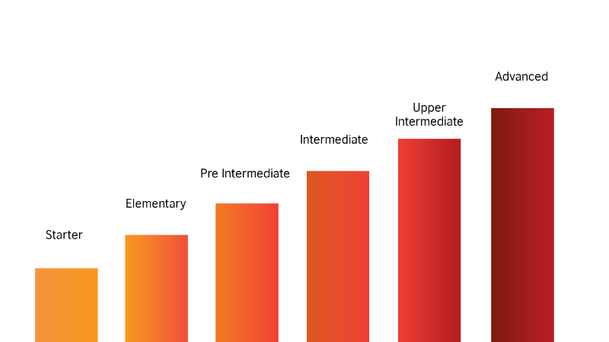
Comparison
Azure Functions
Logic Apps
Power Automate
Notes:
Power automate – fixed per month based on plan (15, 40) or 100 / month / flow (min 5 flows). Also pay as you go option for 60 cents / run
Logic apps – about 20 / hour for CPU, 1.5 cents / hour for memory (lots more to dive into for costs; standard connect vs enterprice connector, integration account or not)
Function apps – 3 different pricing models; resource consumption, execution billing, total consumptions. All have worksheets.
Also, Kubernetes for LogicApps and function apps in preview

Slide 48
Use Case 1 – Process an Email
Customer emails support email address
Trigger Logic App to scan F&O Contacts on customer for “from” email address
If match is found, create a Case for that customer and email named internal support person for that customer
If match cannot be found, forward email to named internal support person assist with general inquiries

Slide 49
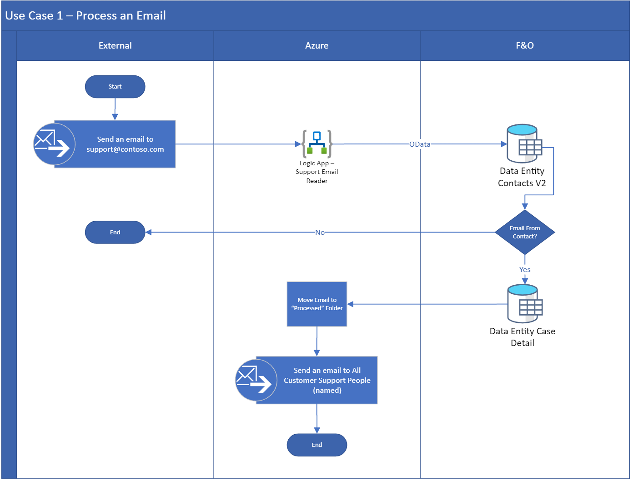

Slide 50
Use Case 2 – Import Currency Exchange Rates
On schedule, invoke API for currency exchange rates
Format data from API for OData Calls
Using OData in F&O, Create the Exchange Rates if not present
Also create exchange rate currency pair if not present

Slide 51
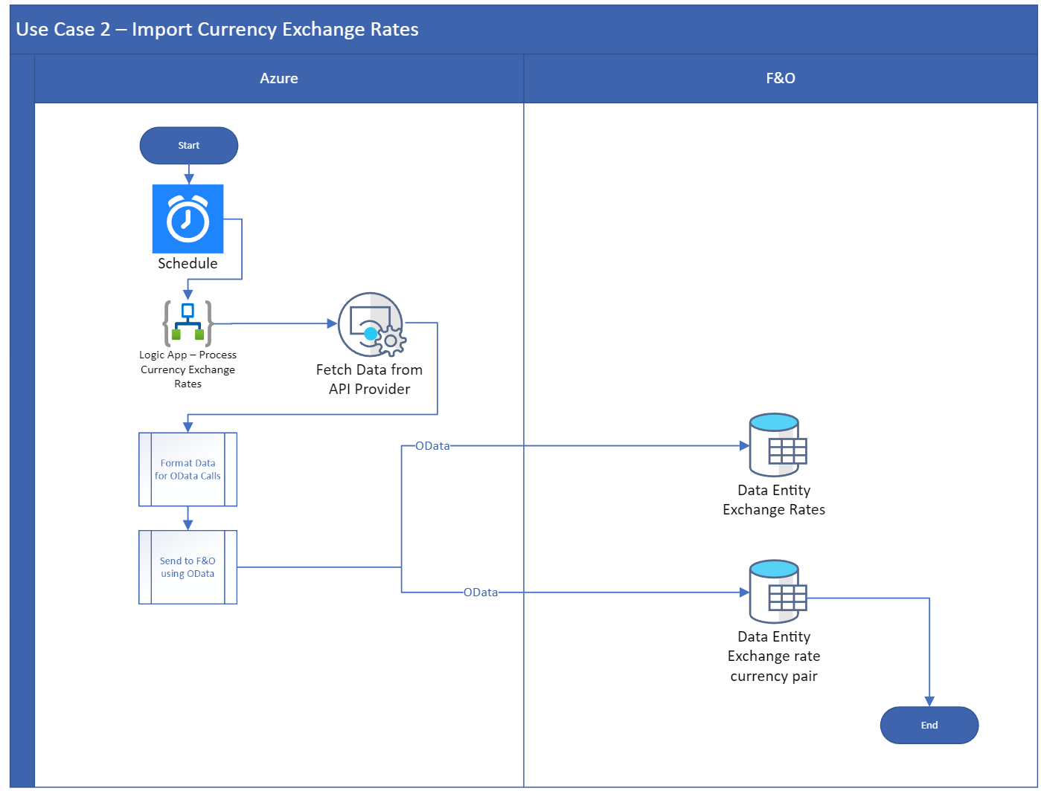

Slide 52
Use Case 3 – Import Currency Exchange Rates (Again!)
On schedule, invoke API for currency exchange rates
Format data from API for CSV file payload
Using Recurring Integration endpoint, drop CSV file for data entity “Currency Exchange Rates”
Using Recurring Integration endpoint, drop CSV file for data entity “Currency Exchange Rate Pair”

Slide 53
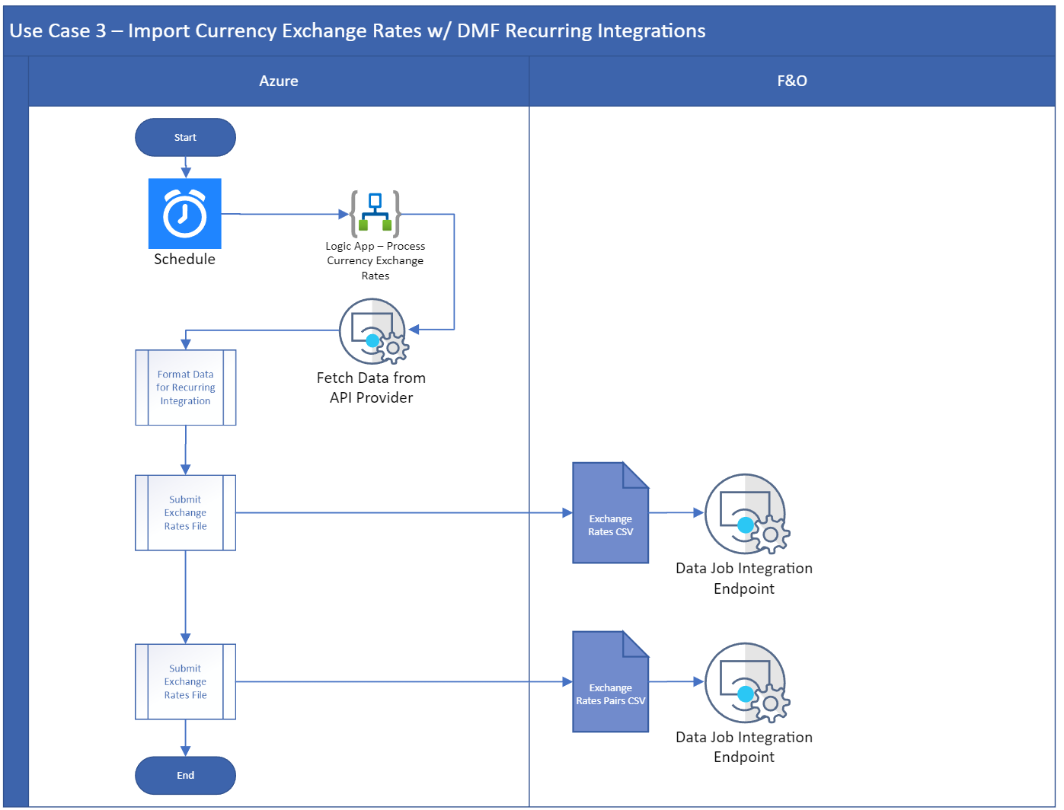

Slide 54
Use Case 4 – Upload Journals (API)
On schedule, have Logic App scan 3rd party system for invoices to pay
Format results for use with OData
Create Journal Header, Create Journal Lines
If no error, then update 3rd party system invoice as in process or pending
If error then delete journal lines, delete journal lines, and send email to IT, AP with error details to address

Slide 55
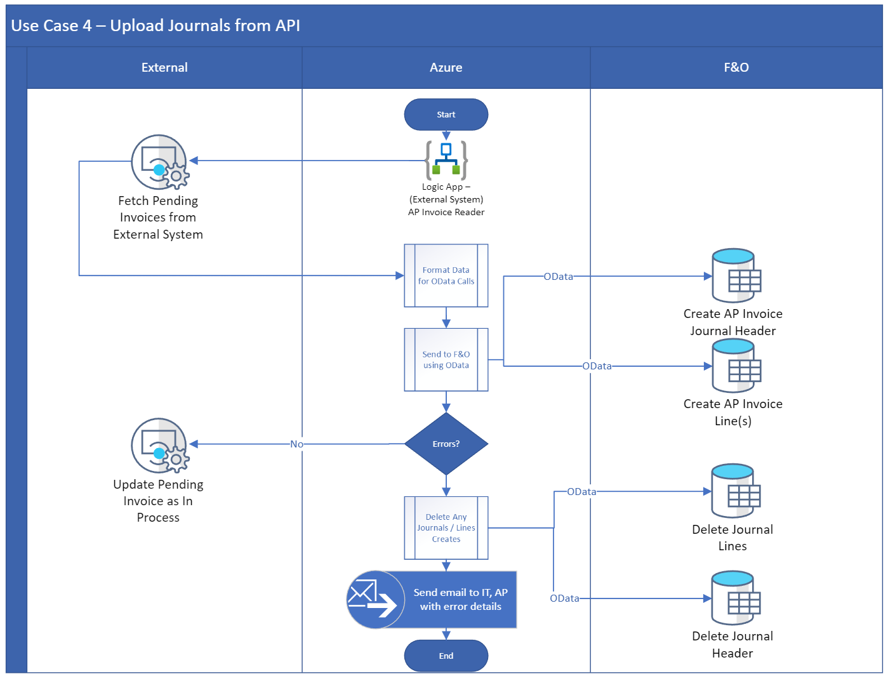

Slide 56
Use Case 4 – Upload Journals (API, Part 2)
In F&O, when vendor invoice payment is journal, trigger Business Event
Logic App responses to Business Event, uses OData to gather supporting info on invoice header and lines
Format Data and call REST API for 3rd party system to mark invoice as paid

Slide 57
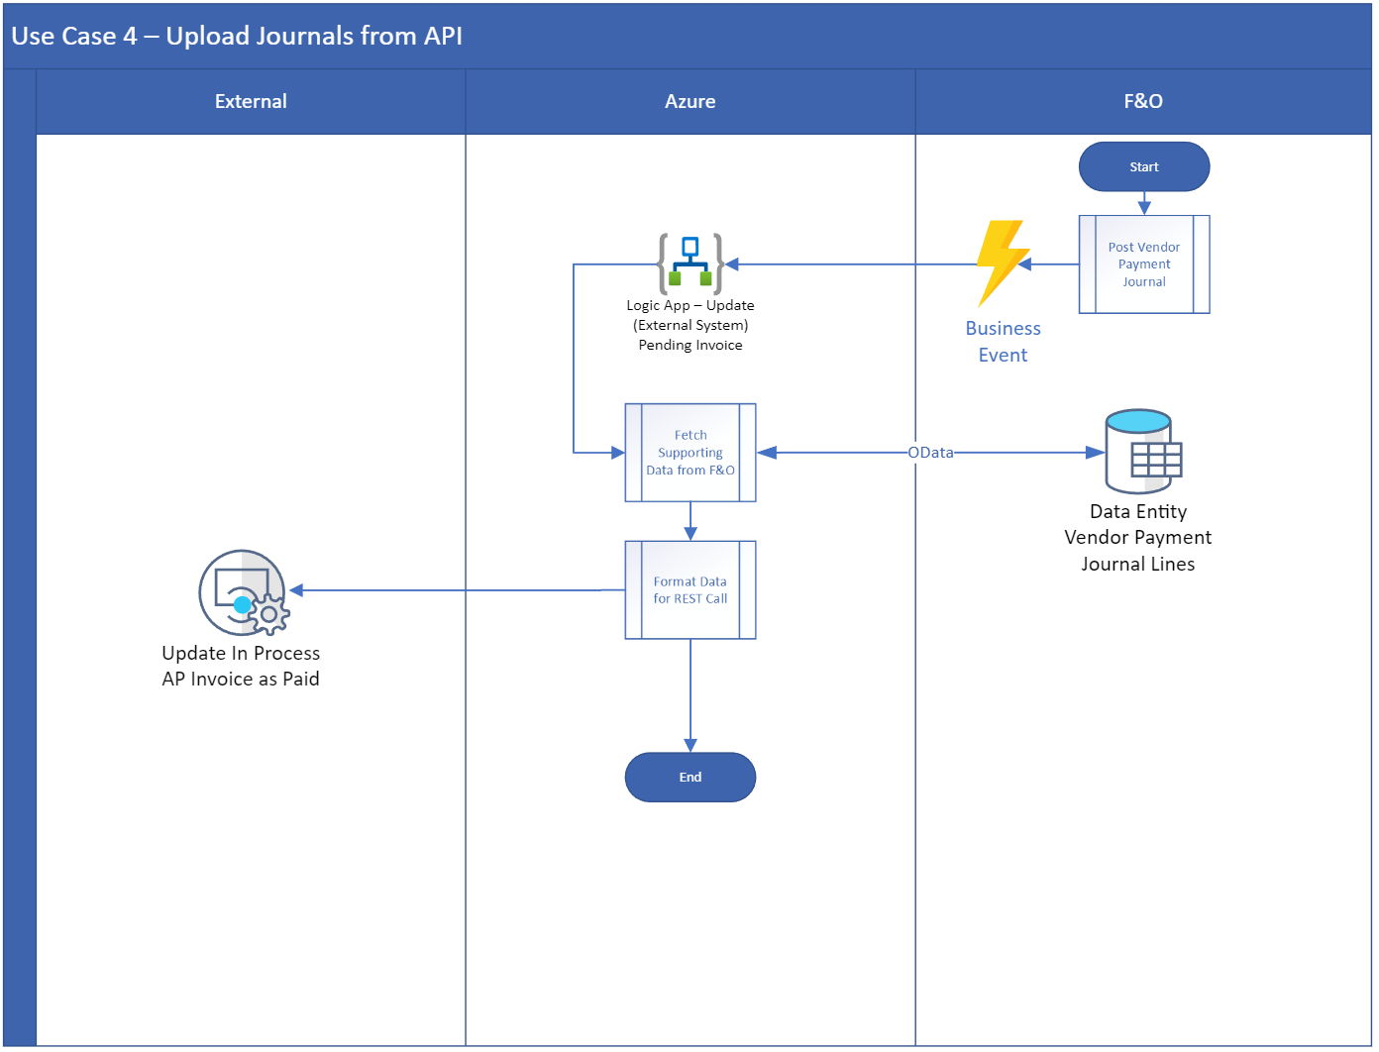

Slide 58
Use Case 5 – Upload Journals (Power App)
In F&O, open Power App on All Production Order Screens for Production Order you want to upload a Report as Finished journal to
Upload RAF journal file to trigger Logic App
Logic App will read tags (with context info) from blob
Using OData, create a RAF Journal header
Using OData and the upload files, create RAF Journal Lines
Invoke Service to Post RAF Journal
Close PowerApp

Slide 59
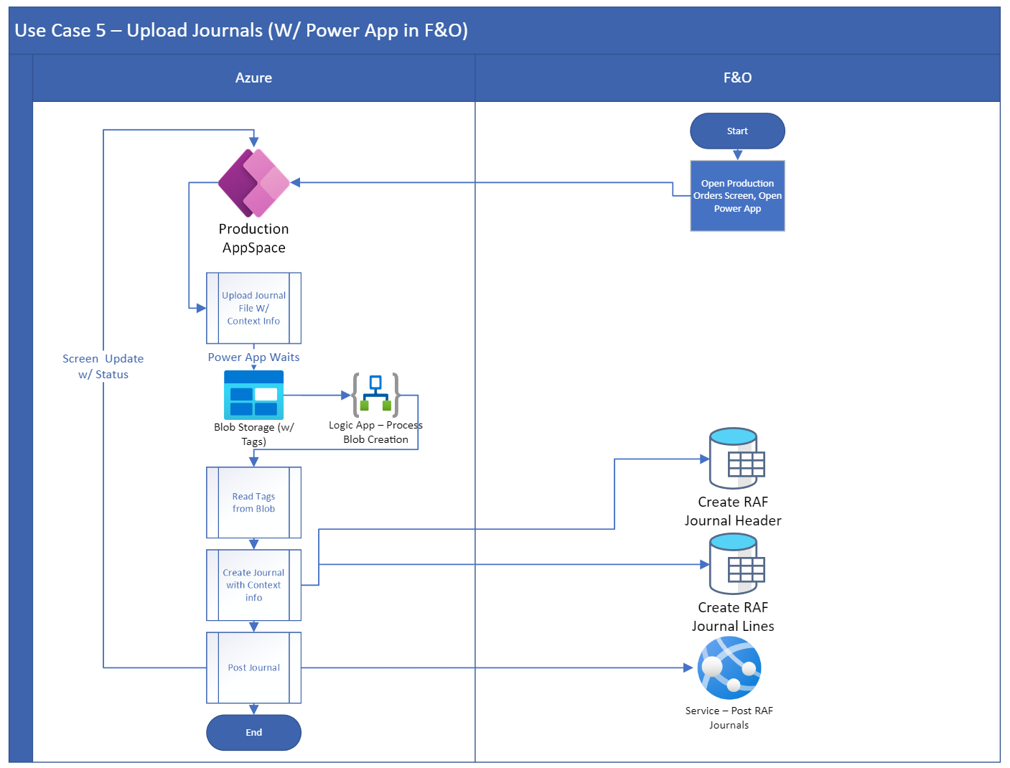

Slide 60
Use Case 6 – Import Orders; F&O (Part 1)
External System captures orders and creates file for FTP pickup
File gets captured, contents stored in Dataverse
Data mapped and XML with data package for F&O created
Drops data package to F&O recurring integration endpoint *
Gets response with GUID, GUID stored in Dataverse as “pending”

Slide 61
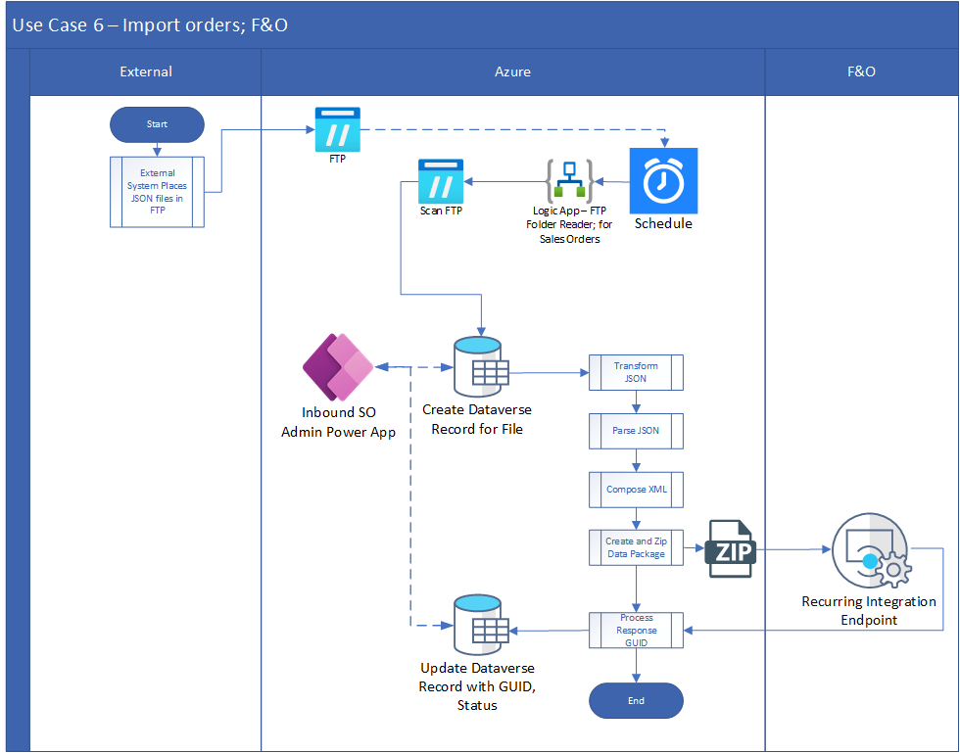

Slide 62
Use Case 6 – Import Orders; F&O (Part 2)
On a schedule, loop through “pending” records
Ask F&O on status of data package by GUID
If status is not success, query for additional details
Store all info in Dataverse
Mark the record as “complete” or “error”

Slide 63
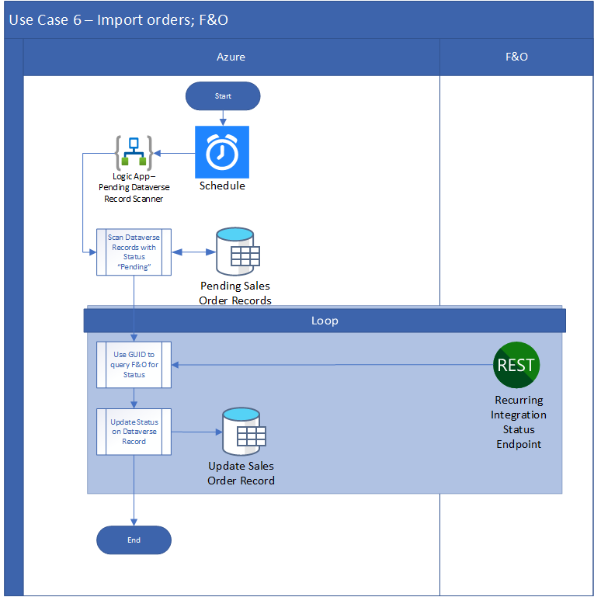

Slide 64
Use Case 7 – Import Orders; AX [2009, 2012] (Part 1)
External System captures orders and creates file for FTP pickup
File gets captured, contents stored in Dataverse and creates GUID for tracking in “created” status
Data mapped and XML file created in blob storage
On schedule, AIF batch job reads from blob storage*
Marks record in Dataverse as “Pending”

Slide 65
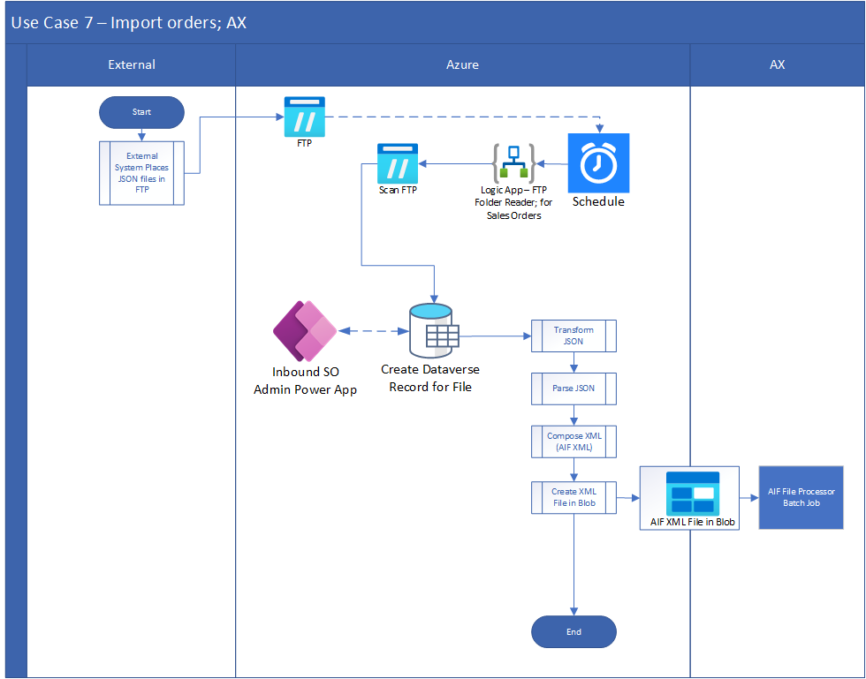

Slide 66
Use Case 7 – Import Orders; AX [2009, 2012] (Part 2)
On a schedule, loop through “pending” records
Ask AX on status of file by GUID using Data Gateway*
If status is not success, query for additional details
Store all info in Dataverse
Mark the record as “complete” or “error”

Slide 67
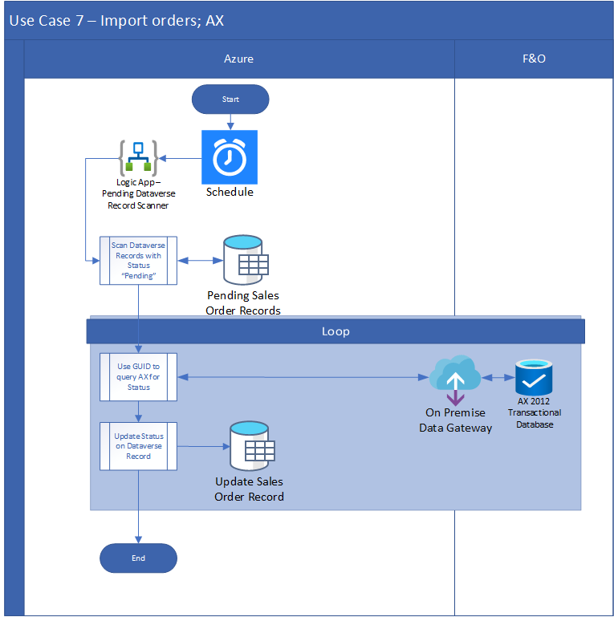

Slide 68
Use Case 8 – Update External Order
External system on a schedule will ask for updates on an order
External system will hit LogicApp API with order info
LogicApp will query Synapse for order details
Results for Sales Order, Packing Slips, Invoices, etc. will be stored in a JSON construct
Return data as JSON to external system

Slide 69
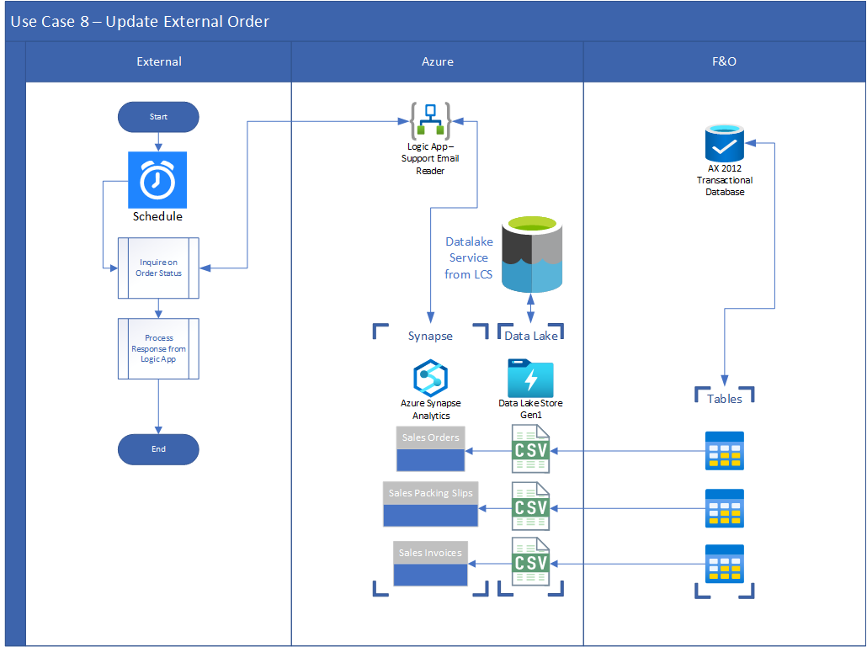

Slide 70
Demo
Drupal eCommerce
F&O
No Customizations in either
Logic Apps only integrating data
Approx. Time: 24 hours

Slide 71
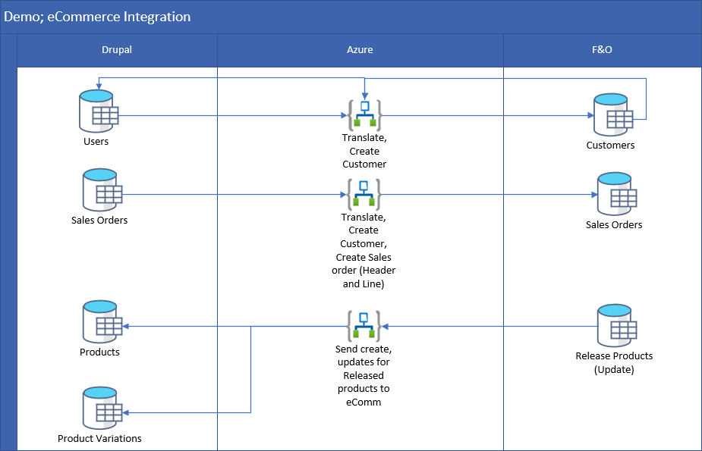

Slide 72
DEMO

Slide 73
Scaling – Event Grid
Monitor events on a larger set of cloud assets
Connect events with event handlers
Event subscription management in a central place
Fully Managed and pay per execution
Simplify event delivery
Build reliable cloud applications
Streamline event-driven integration
Notes:
Simplify event delivery
Eliminate polling—and the associated cost and latency. With Event Grid, event publishers are decoupled from event subscribers using a pub/sub model and simple HTTP-based event delivery allowing you to build scalable serverless applications, microservices, and distributed systems.
Build reliable cloud applications
Gain massive scale, dynamically, while getting near-real-time notifications for changes you're interested in. Build better, more reliable applications through reactive programming, capitalizing on guaranteed event delivery and the high availability of the cloud.

Slide 74
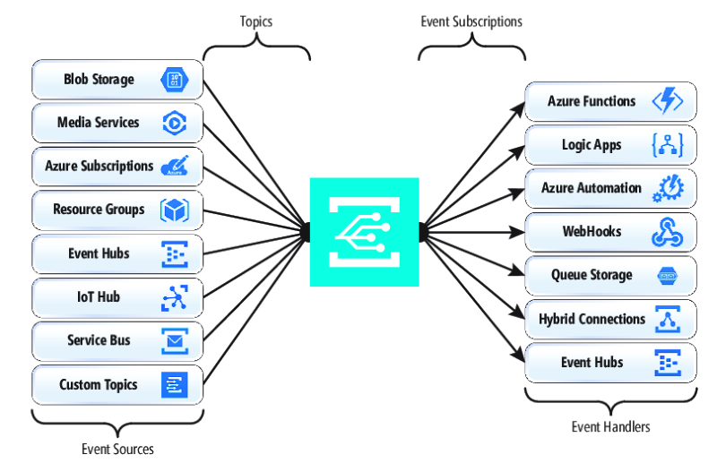
Who?
Where?
What?
When?

Slide 76
Scaling – API Management
Deploy and manage APIs from a central place across different clouds, instances, and on premise data sources
Protect API resources
Improve API discoverability
Modernize and secure APIs
Notes:
Deploy API gateways side-by-side with the APIs hosted in Azure, other clouds, and on-premises, optimizing API traffic flow. Meet security and compliance requirements while enjoying a unified management experience and full observability across all internal and external APIs.
Help protect your resources
Control how data and services are exposed to employees, partners, and customers by applying authentication, authorization, and usage limits.
Improve API discoverability
Create a customizable developer portal for all your APIs. Easily manage and share APIs with internal teams, external partners, and customers.
modernize
Automatically turn legacy web services into modern REST-based APIs by creating façades for your back-end services. See how innovators like Vipps, a leading payment service in Norway, are revolutionizing development using Azure API Management.
Keep all your APIs behind a single static IP or domain, and help protect them with keys, tokens, and IP filtering.
Enforce flexible and fine-grained quotas and rate limits. Modify the shape and behavior of your APIs using policies. Improve latency and scale your APIs with response caching.
Connect on-premises APIs to cloud services by creating a façade that lets you safely integrate on-premises and cloud environments.

Slide 77
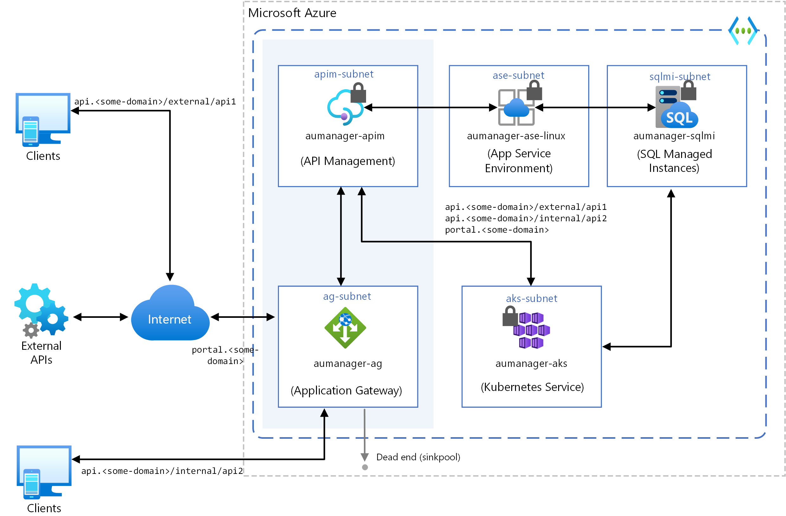

Slide 78
Summary
If it talks, we can read it
If it understands, we can integrate to it
If it emits data, we can act on it
If it generates, we can process
if it has data, we can consume it

Slide 80
Give Away
Also, all of my PowerPoints will be available for download at https://github.com/NathanClouseAX/CommunityPresentations/tree/master/2022 by end of the week

